Slide 1
EMTH403
Mathematical Foundation for Computer Science

Slide 2
Lecture Outcomes
understand what is antisymmetric relation.
understand what is transitive relation.

Slide 3
Properties of Relations - Antisymmetric
A relation R on a set A such that for all a, b ∈ A, if (a, b) ∈ R and (b, a) ∈ R, then a = b is called antisymmetric.
Similarly, the relation R on the set A is antisymmetric if
∀a∀b(((a, b) ∈ R ∧ (b, a) ∈ R) → (a = b)).

Slide 4
Properties of Relations – Antisymmetric Example 1
Ques:- Consider the following relations on {1, 2, 3, 4}:
Is it antisymmetric(∀a∀b(((a, b)∈R∧(b, a) ∈ R)→(a= b)))?
R4 = {(2, 1), (3, 1), (3, 2), (4, 1), (4, 2), (4, 3)}
Ans:- R4 is antisymmetric.

Slide 5
Properties of Relations – Antisymmetric Example 2
Ques:- Consider the following relations on {1, 2, 3, 4}:
Is it antisymmetric (∀a∀b(((a, b) ∈ R ∧ (b, a) ∈ R) → (a = b)).) ?
R5 = {(1, 1), (1, 2), (1, 3), (1, 4), (2, 2), (2, 3), (2, 4), (3, 3), (3, 4), (4, 4)}
Ans:- R5 is antisymmetric.

Slide 6
Properties of Relations – Antisymmetric Example 3
Ques:- Consider the following relations on {1, 2, 3, 4}:
Is it antisymmetric(∀a∀b(((a, b) ∈ R ∧ (b, a) ∈ R) → (a = b)).) ?
R6 = {(3, 4)}
Ans:- R6 is antisymmetric.

Slide 7
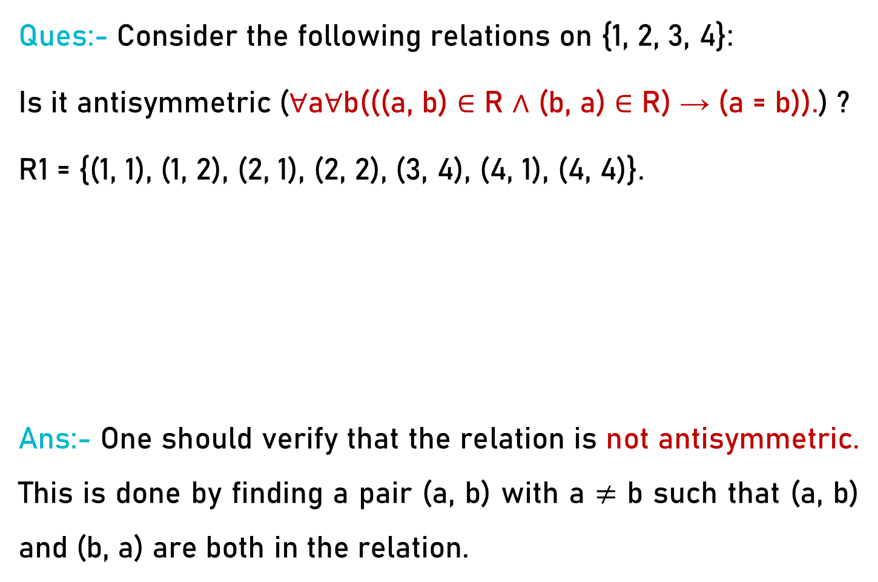
Properties of Relations – Antisymmetric Example 4
Ques:- Consider the following relations on {1, 2, 3, 4}:
Is it antisymmetric (∀a∀b(((a, b) ∈ R ∧ (b, a) ∈ R) → (a = b)).) ?
R1 = {(1, 1), (1, 2), (2, 1), (2, 2), (3, 4), (4, 1), (4, 4)}.
Ans:- One should verify that the relation is not antisymmetric. This is done by finding a pair (a, b) with a $≠$ b such that (a, b) and (b, a) are both in the relation.

Slide 8
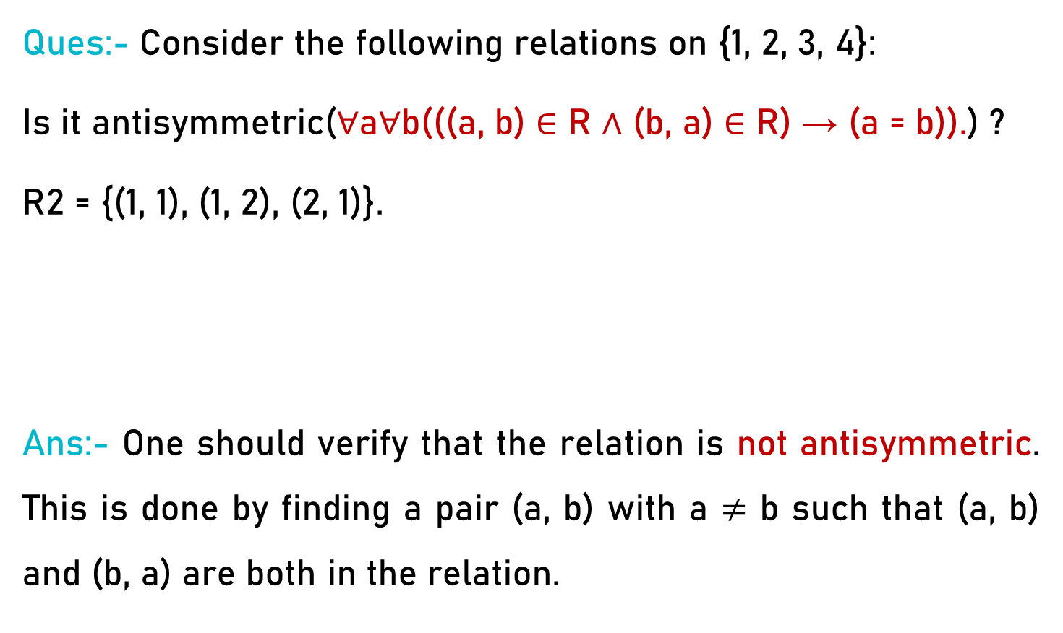
Properties of Relations – Antisymmetric Example 5
Ques:- Consider the following relations on {1, 2, 3, 4}:
Is it antisymmetric(∀a∀b(((a, b) ∈ R ∧ (b, a) ∈ R) → (a = b)).) ?
R2 = {(1, 1), (1, 2), (2, 1)}.
Ans:- One should verify that the relation is not antisymmetric. This is done by finding a pair (a, b) with a $≠$ b such that (a, b) and (b, a) are both in the relation.

Slide 9
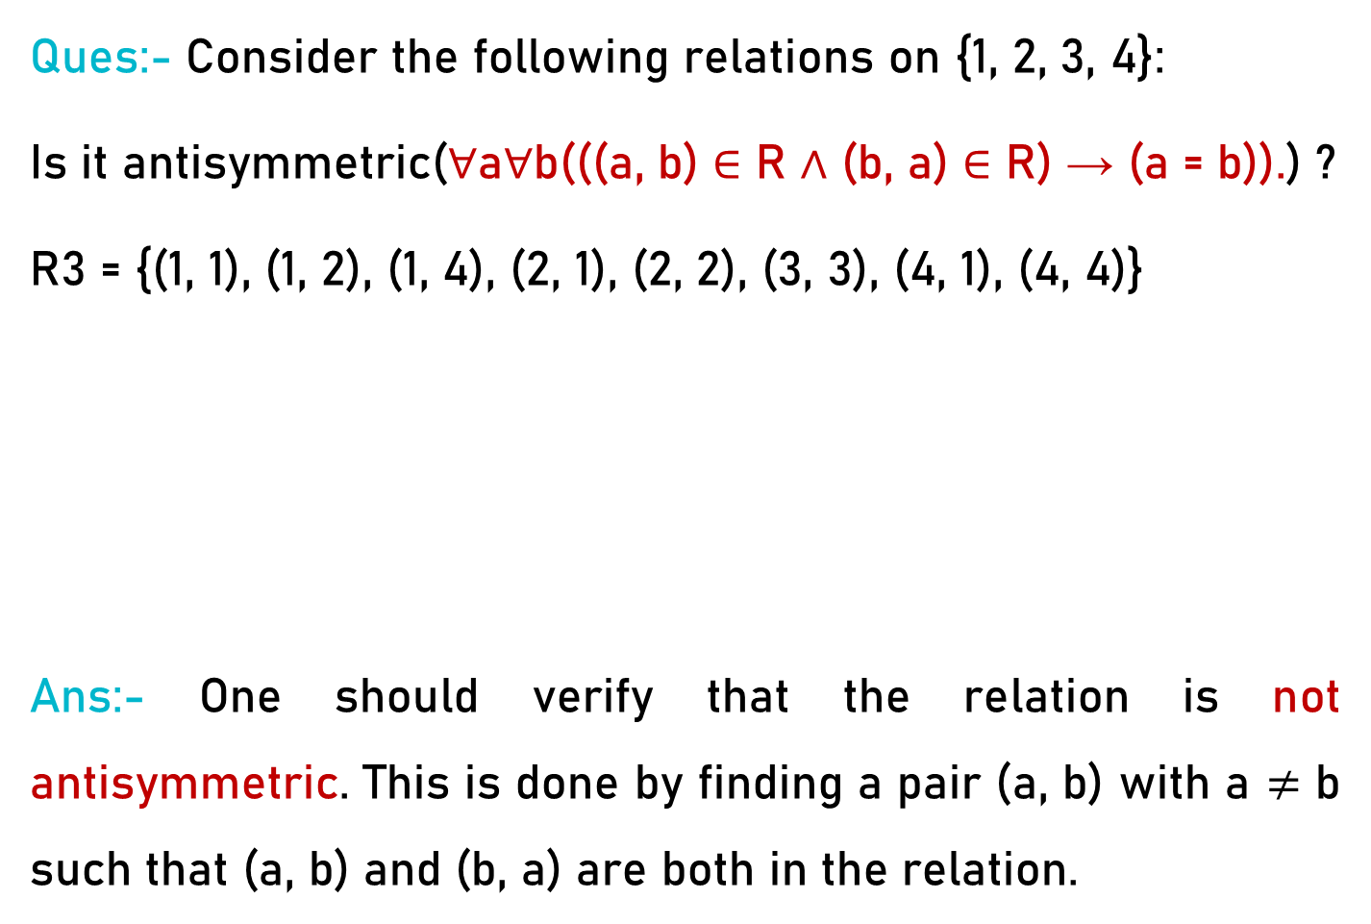
Properties of Relations – Antisymmetric Example 6
Ques:- Consider the following relations on {1, 2, 3, 4}:
Is it antisymmetric(∀a∀b(((a, b) ∈ R ∧ (b, a) ∈ R) → (a = b)).) ?
R3 = {(1, 1), (1, 2), (1, 4), (2, 1), (2, 2), (3, 3), (4, 1), (4, 4)}
Ans:- One should verify that the relation is not antisymmetric. This is done by finding a pair (a, b) with a $≠$ b such that (a, b) and (b, a) are both in the relation.

Slide 10
Properties of Relations – Antisymmetric Example 7
Ques:- Is the “divides” relation on the set of positive integers antisymmetric?
Ans:- It is antisymmetric, for if a and b are positive integers with a |b and b |a, then a = b.

Slide 11
Properties of Relations - Transitive
A relation R on a set A is called transitive if whenever (a, b) ∈ R and (b, c) ∈ R, then (a, c) ∈ R, for all a, b, c ∈ A.
Remark: Using quantifiers we see that the relation R on a set A is transitive if we have
∀a∀b∀c(((a, b) ∈ R ∧ (b, c) ∈ R) → (a, c) ∈ R).

Slide 12
Properties of Relations – Transitive Example 1
Ques:- Is the following relation transitive?
R4 = {(2, 1), (3, 1), (3, 2), (4, 1), (4, 2), (4, 3)}.
Ans:- R4 is transitive, because (3, 2) and (2, 1), (4, 2) and (2, 1), (4, 3) and (3, 1), and (4, 3) and (3, 2) are the only such sets of pairs, and (3, 1), (4, 1), and (4, 2) belong to R4.

Slide 13
Properties of Relations – Transitive Example 2
Ques:- Is the following relation transitive?
R5 = {(1, 1), (1, 2), (1, 3), (1, 4), (2, 2), (2, 3), (2, 4), (3, 3), (3, 4), (4, 4)}.
Ans:- R5 is transitive

Slide 14
Properties of Relations – Transitive Example 3
Ques:- Is the following relation transitive?
R6 = {(3, 4)}.
Ans:- R6 is transitive

Slide 15
Properties of Relations – Transitive Example 4
Ques:- Is the following relation transitive?
R1 = {(1, 1), (1, 2), (2, 1), (2, 2), (3, 4), (4, 1), (4, 4)}.
Ans:- R1 is not transitive because (3, 4) and (4, 1) belong to R1, but (3, 1) does not

Slide 16
Properties of Relations – Transitive Example 5
Ques:- Is the following relation transitive?
R2 = {(1, 1), (1, 2), (2, 1)}.
Ans:- R2 is not transitive because (2, 1) and (1, 2) belong to R2, but (2, 2) does not.

Slide 17
Properties of Relations – Transitive Example 6
Ques:- Is the following relation transitive?
R3 = {(1, 1), (1, 2), (1, 4), (2, 1), (2, 2), (3, 3), (4, 1), (4, 4)}
Ans:- R3 is not transitive because (4, 1) and (1, 2) belong to R3, but (4, 2) does not.

Slide 18
Properties of Relations – Transitive Example 7
Ques:- Is the “divides” relation on the set of positive integers transitive?
Ans:- Suppose that a divides b and b divides c. Then there are positive integers k and l such that b = ak and c = bl. Hence, c = a(kl), so a divides c. It follows that this relation is transitive.

